Slide 1

Continual Learning Techniques for Image Classification
Finlay Boyle
Supervised by Dr Donald Sturgeon
Durham University, Department of Computer Science
Notes:
Continual Learning Techniques for Image Classification

Slide 2
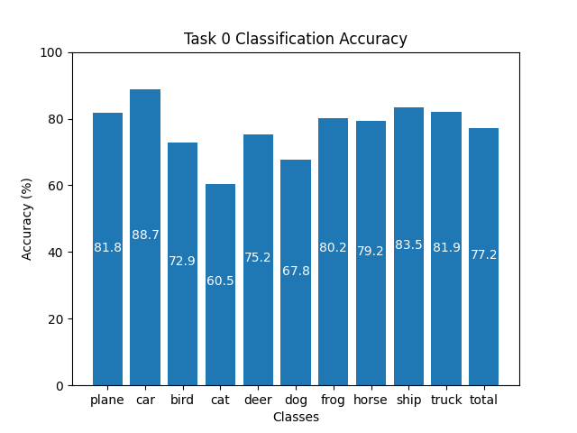
Training Machine Learning Models
Standard training technique: Offline Training
Repeated optimisation over batches
Requires access to entire dataset
High-quality results
Limitations:
Restrictive dataset requirement
Suffers from Catastrophic Forgetting
Figure 1: Offline Training on CIFAR-10 for 100 epochs
Notes:
The standard method to train machine learning models to classify images is to split a dataset into batches and use these batches to repeatedly optimise the parameters of a model via backpropagation. This is known as Offline Training.
[Use Laser] As Figure 1 shows, Offline Training is capable of producing high-quality results. The chart shows the classification accuracy of a ResNet-18 model trained for 100 epochs on the CIFAR-10 dataset where it attains an average classification accuracy of over 77% and performs well on each class individually.
However, Offline Training is limited by the requirement to have the dataset available in its entirety at training time. If it is infeasible to do so, or the data is real-time then Offline Training is unsuitable due to a fe-nom-en-non known as Catastrophic Forgetting.

Slide 3
Catastrophic Forgetting
Catastrophic Forgetting: The complete and sudden loss of previously acquired knowledge in a neural network [1]
Sequentially updating with new data causes forgetting
Offline Training lacks context of prior knowledge
Ability to learn continually often ignored [2]
Notes:
Catastrophic Forgetting is defined as the complete and sudden loss of previously acquired knowledge in a neural network.
It is caused by training an already trained model on unseen data. The model overwrites the weights and biases it has learnt previously causing it to forget the knowledge it has gained. The ability of a neural network to learn continuously is often overlooked and, at a high-level, is caused by the lack of context that existing weights represent acquired knowledge.

Slide 4
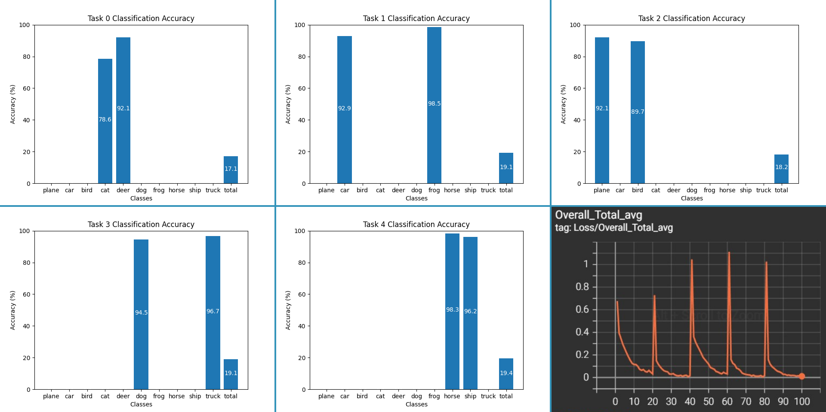
Example of Catastrophic Forgetting
Figure 2: Applying Offline Training sequentially to the same model with separate tasks causes Catastrophic Forgetting. Bottom right: Overall loss. Other images are classification accuracy.
Notes:
In this example, I have split the CIFAR-10 dataset into 5 disjoint tasks each containing 2 classes without replacement. A ResNet-18 model is then trained sequentially on the tasks for 20 epochs each. [Use Laser] as you can see in Figure 2, the model forgets about the previous tasks and overwrites the knowledge.
The final graph [Laser Position] shows the loss peaking as each new task is introduced and decreasing as the model is trained.

Slide 5
Continual Learning
Continual Learning: A collection of techniques to overcome Catastrophic Forgetting [3]
Rose to prominence with Elastic Weight Consolidation in 2017 [4] and is actively researched
Primarily focused on alternative methods to Offline Training
Smaller focus on network architecture [5] and dynamic networks
Does not require access to entire dataset
Notes:
Continual Learning is the study of techniques to reduce the effect of Catastrophic Forgetting while trying to match the performance of Offline Training. Elastic Weight Consolidation, a technique that penalises changes to weights that are important to previous tasks, was one of the first techniques that gave rise to the field.
The literature since then has mainly focused on alternatives to Offline Training, but there has been a recent interest into how the architecture of a model may contribute to forgetting. The main difference from Offline Training is the relaxation of the requirement for the whole dataset to be present at training time.

Slide 6
Part I: Literature Evaluation
Initial focus on implementing and evaluating existing techniques
Aim: provide a robust comparison between existing methods
Deliverables:
Implementation of Baselines: Finetuning and Offline Training
Historical Techniques such as Elastic Weight Consolidation [4]
State of the Art: GDumb [6], Rainbow [7], Mnemonics [8]
Cutting Edge: Learning to Prompt [9] and meta-learning techniques [10]
Evaluation and comparison of techniques
Notes:
Initially, the focus of my project will be on implementing and comparing techniques from the literature. This is important because of ongoing issues in the literature which were highlighted by the authors of a technique known as GDumb. They argued that many techniques are not applicable to the real-world because of restrictive assumptions made by their authors. As such, it is difficult to fairly compare recent state of the art techniques.
This will start with implementation of the baselines: Offline Training and Finetuning, which is similar to the catastrophic forgetting example shown earlier and represents the lower bound. The goal is to match Offline Trainings results.
After this, I will implement historical techniques such as Elastic Weight Consolidation as discussed previously. Next, I will implement the current state of the art such as GDumb, a method that stores a subset of data and trains a classifier at inference time on this subset, Rainbow, another method that samples data that is representative of its own class and discriminative against others, and Mnemonics which also stores samples but optimises the samples themselves during training. Following this, I will implement cutting edge techniques that are presenting new approaches such as Learning to Prompt, a technique that learns small inputs to be prepended to the input prior to classification, and meta-learning techniques that learn how to preserve knowledge during training.
Finally, to evaluate and compare these methods I will conduct fair experiments and use metrics such as overall accuracy, time taken to train, memory consumption, and continual learning specific metrics such as average forgetting which measures the decrease in performance between tasks where applicable.

Slide 7
Part II: Novel Experimentation
Focus will shift to gaps in the literature
Aim: experiment with potential future research areas
Will be influenced by the cutting-edge techniques
Experimenting with architecture [5]
Experimenting with sampling methods
Deliverables:
Establishing a theoretical underpinning to any experimentation to ensure there exists potential
Implementation of experiments and potentially any different approaches found
Evaluation and comparison with techniques from Part I
Notes:
Following this, I will focus on experimenting with gaps in the literature with the aim to contribute something novel to the field. This will be influenced by the cutting-edge techniques as well as potentially experimenting with the architecture of the model. This will involve explaining and understanding the theoretical underpinning, implementing these ideas, and comparing them to existing techniques using the same metrics previously mentioned.
Some potential avenues for this part are exploring improvements to sampling techniques, experimenting feature extraction methods, and investigating dynamic network structures.

Slide 8
Applications of Continual Learning
Continual Learning offers real-world benefits
Training models can be expensive [11]
Continual Learning could save computational resources and time [12]
Real-time applications can adapt to changing data distributions
Mainly focused on Image Classification
Can be applied to other domains such as Natural Language Processing [13]
Notes:
Continual Learning offers real-world benefits. Training, and retraining, models is costly in terms of energy usage, computational resources, and time. If Continual Learning research is able to propose techniques that are capable of preserving knowledge in existing models this has the potential to significantly reduce the cost of updating models.
Furthermore, there would be major benefits for real-time applications as well. For example, incoming data could be used to update a model on the fly in near real-time to improve the output of a model incrementally. This could give adopters of Continual Learning an edge over competitors while also realising the benefits of cost reductions at the same time.
It is also important to note that Image Classification is the main domain used for research, but the techniques can also be applied to other domains such as Natural Language Processing.

Slide 9
References
[1] McCloskey, Michael, and Neal J. Cohen. "Catastrophic interference in connectionist networks: The sequential learning problem." Psychology of learning and motivation. Vol. 24. Academic Press, 1989. 109-165.
[2] Hecht-Nielsen, Robert. "Neurocomputing: picking the human brain." IEEE spectrum 25.3 (1988): 36-41.
[3] Parisi, German I., et al. "Continual lifelong learning with neural networks: A review." Neural Networks 113 (2019): 54-71.
[4] Kirkpatrick, James, et al. "Overcoming catastrophic forgetting in neural networks." Proceedings of the national academy of sciences 114.13 (2017): 3521-3526.
[5] Mirzadeh, Seyed Iman, et al. "Architecture matters in continual learning." arXiv preprint arXiv:2202.00275 (2022).
[6] Prabhu, Ameya, Philip HS Torr, and Puneet K. Dokania. "Gdumb: A simple approach that questions our progress in continual learning." European conference on computer vision. Springer, Cham, 2020.
[7] Bang, Jihwan, et al. "Rainbow memory: Continual learning with a memory of diverse samples." Proceedings of the IEEE/CVF Conference on Computer Vision and Pattern Recognition. 2021.
[8] Liu, Yaoyao, et al. "Mnemonics training: Multi-class incremental learning without forgetting." Proceedings of the IEEE/CVF conference on Computer Vision and Pattern Recognition. 2020.
[9] Wang, Zifeng, et al. "Learning to prompt for continual learning." Proceedings of the IEEE/CVF Conference on Computer Vision and Pattern Recognition. 2022.
[10] Hadsell, Raia, et al. "Embracing change: Continual learning in deep neural networks." Trends in cognitive sciences 24.12 (2020): 1028-1040.
[11] Wiggers, Kyle. "AI Weekly: AI Model Training Costs on the Rise, Highlighting Need for New Solutions." VentureBeat, 15 Oct. 2021, https://venturebeat.com/ai/ai-weekly-ai-model-training-costs-on-the-rise-highlighting-need-for-new-solutions/.
[12] Mai, Zheda, et al. "Online continual learning in image classification: An empirical survey." Neurocomputing 469 (2022): 28-51.
[13] Biesialska, Magdalena, Katarzyna Biesialska, and Marta R. Costa-Jussa. "Continual lifelong learning in natural language processing: A survey." arXiv preprint arXiv:2012.09823 (2020).
Notes:
Thank you for listening, here are the references for the presentation.

